Slide 1


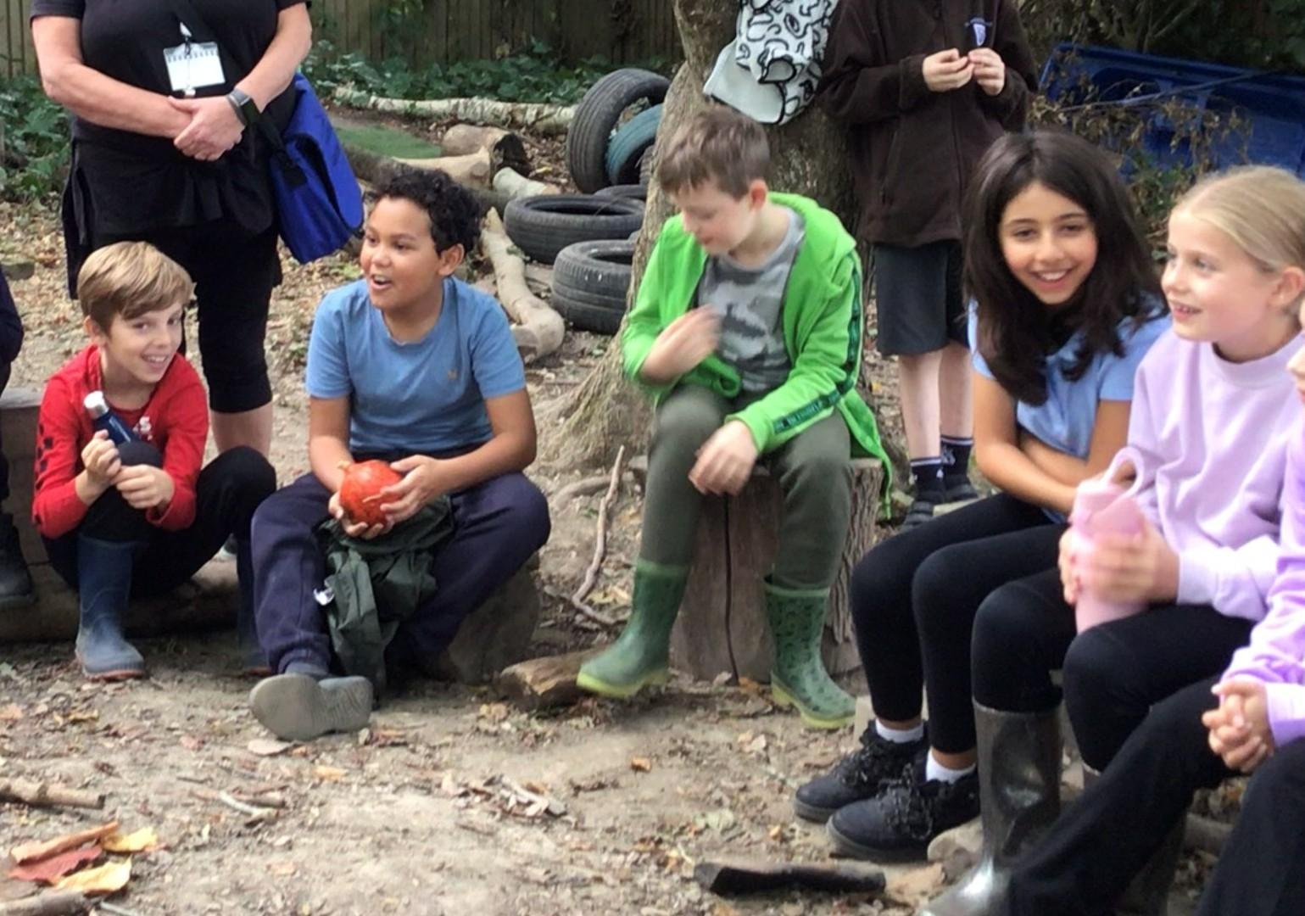
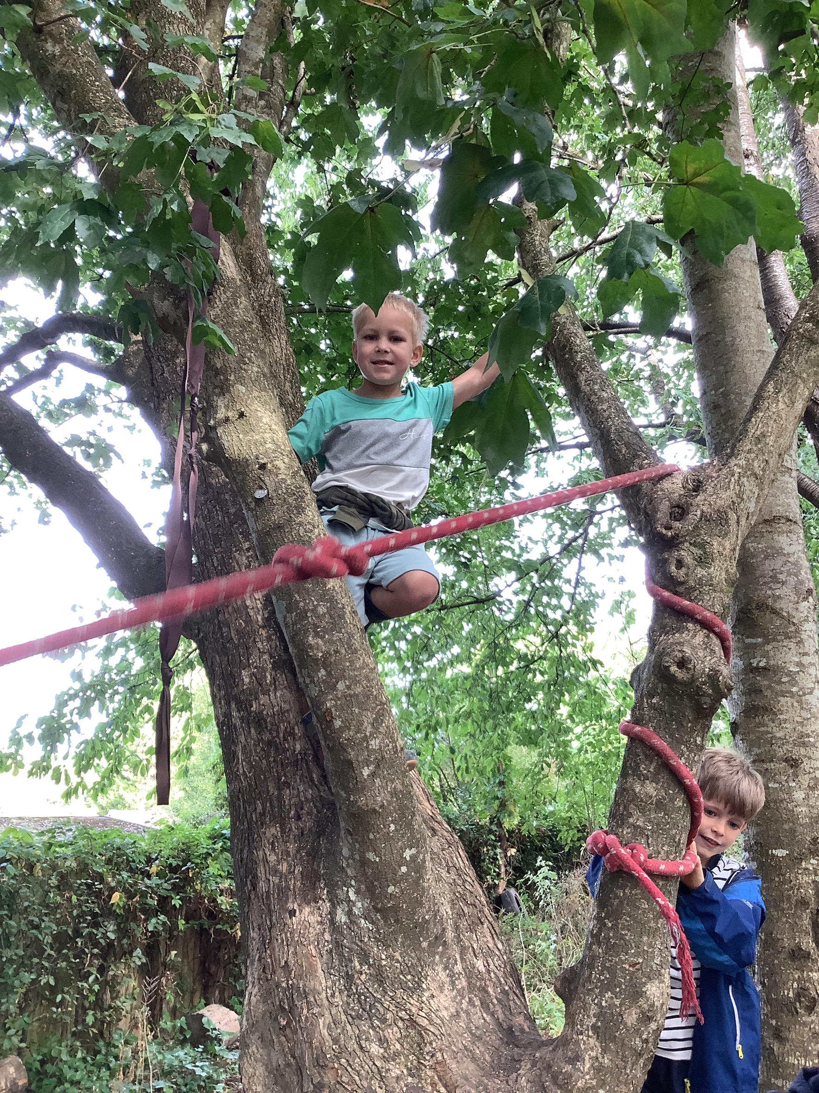
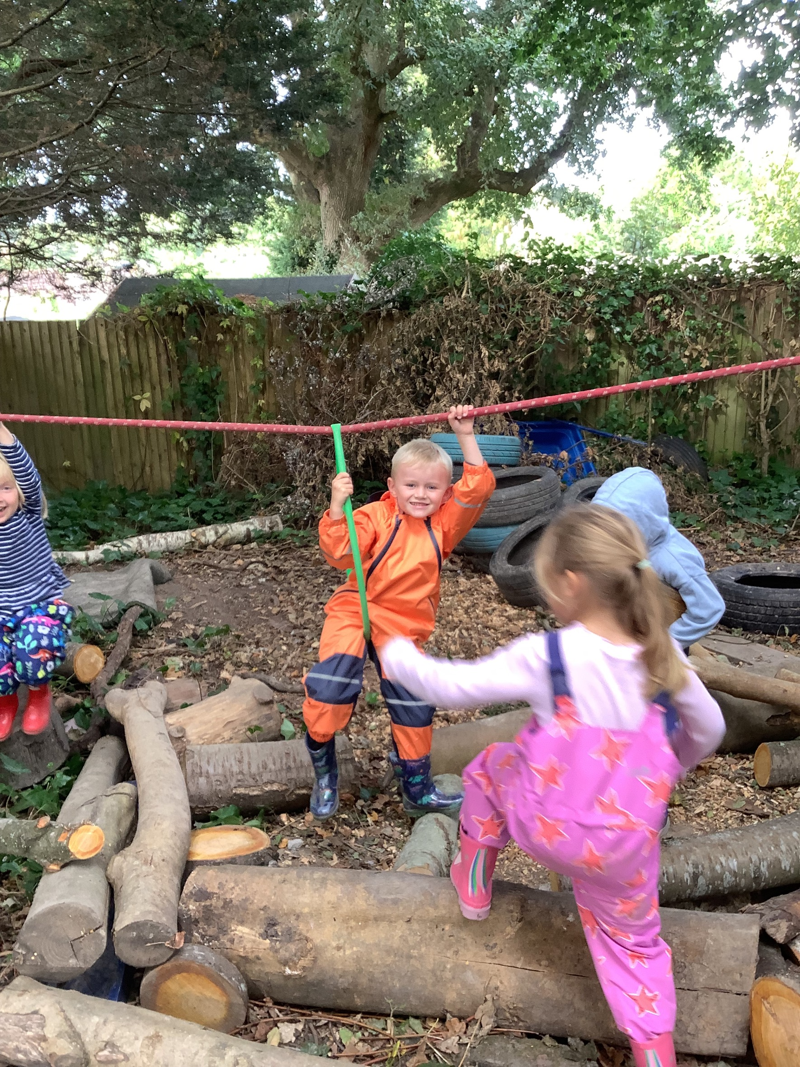
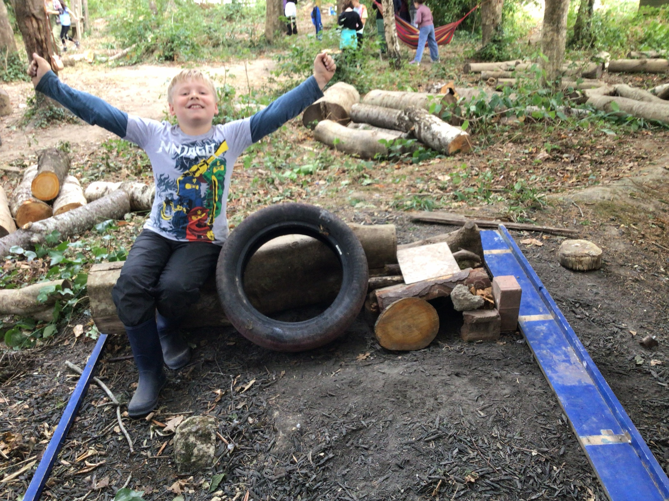
25th September 2026
BLACKTHORNS NEWSLETTER
🌿 Forest School is Back! 🌿
Our Year 1 and Year 5 children had a brilliant first session at Forest School yesterday! It was wonderful to see them exploring the outdoors, developing new skills and enjoying the opportunity to learn in such a different environment. We are looking forward to seeing them grow in confidence and make the most of their Forest School experiences over the coming weeks. A huge thank you to FOBs for funding these sessions and making this fantastic opportunity possible for our children.

Slide 2
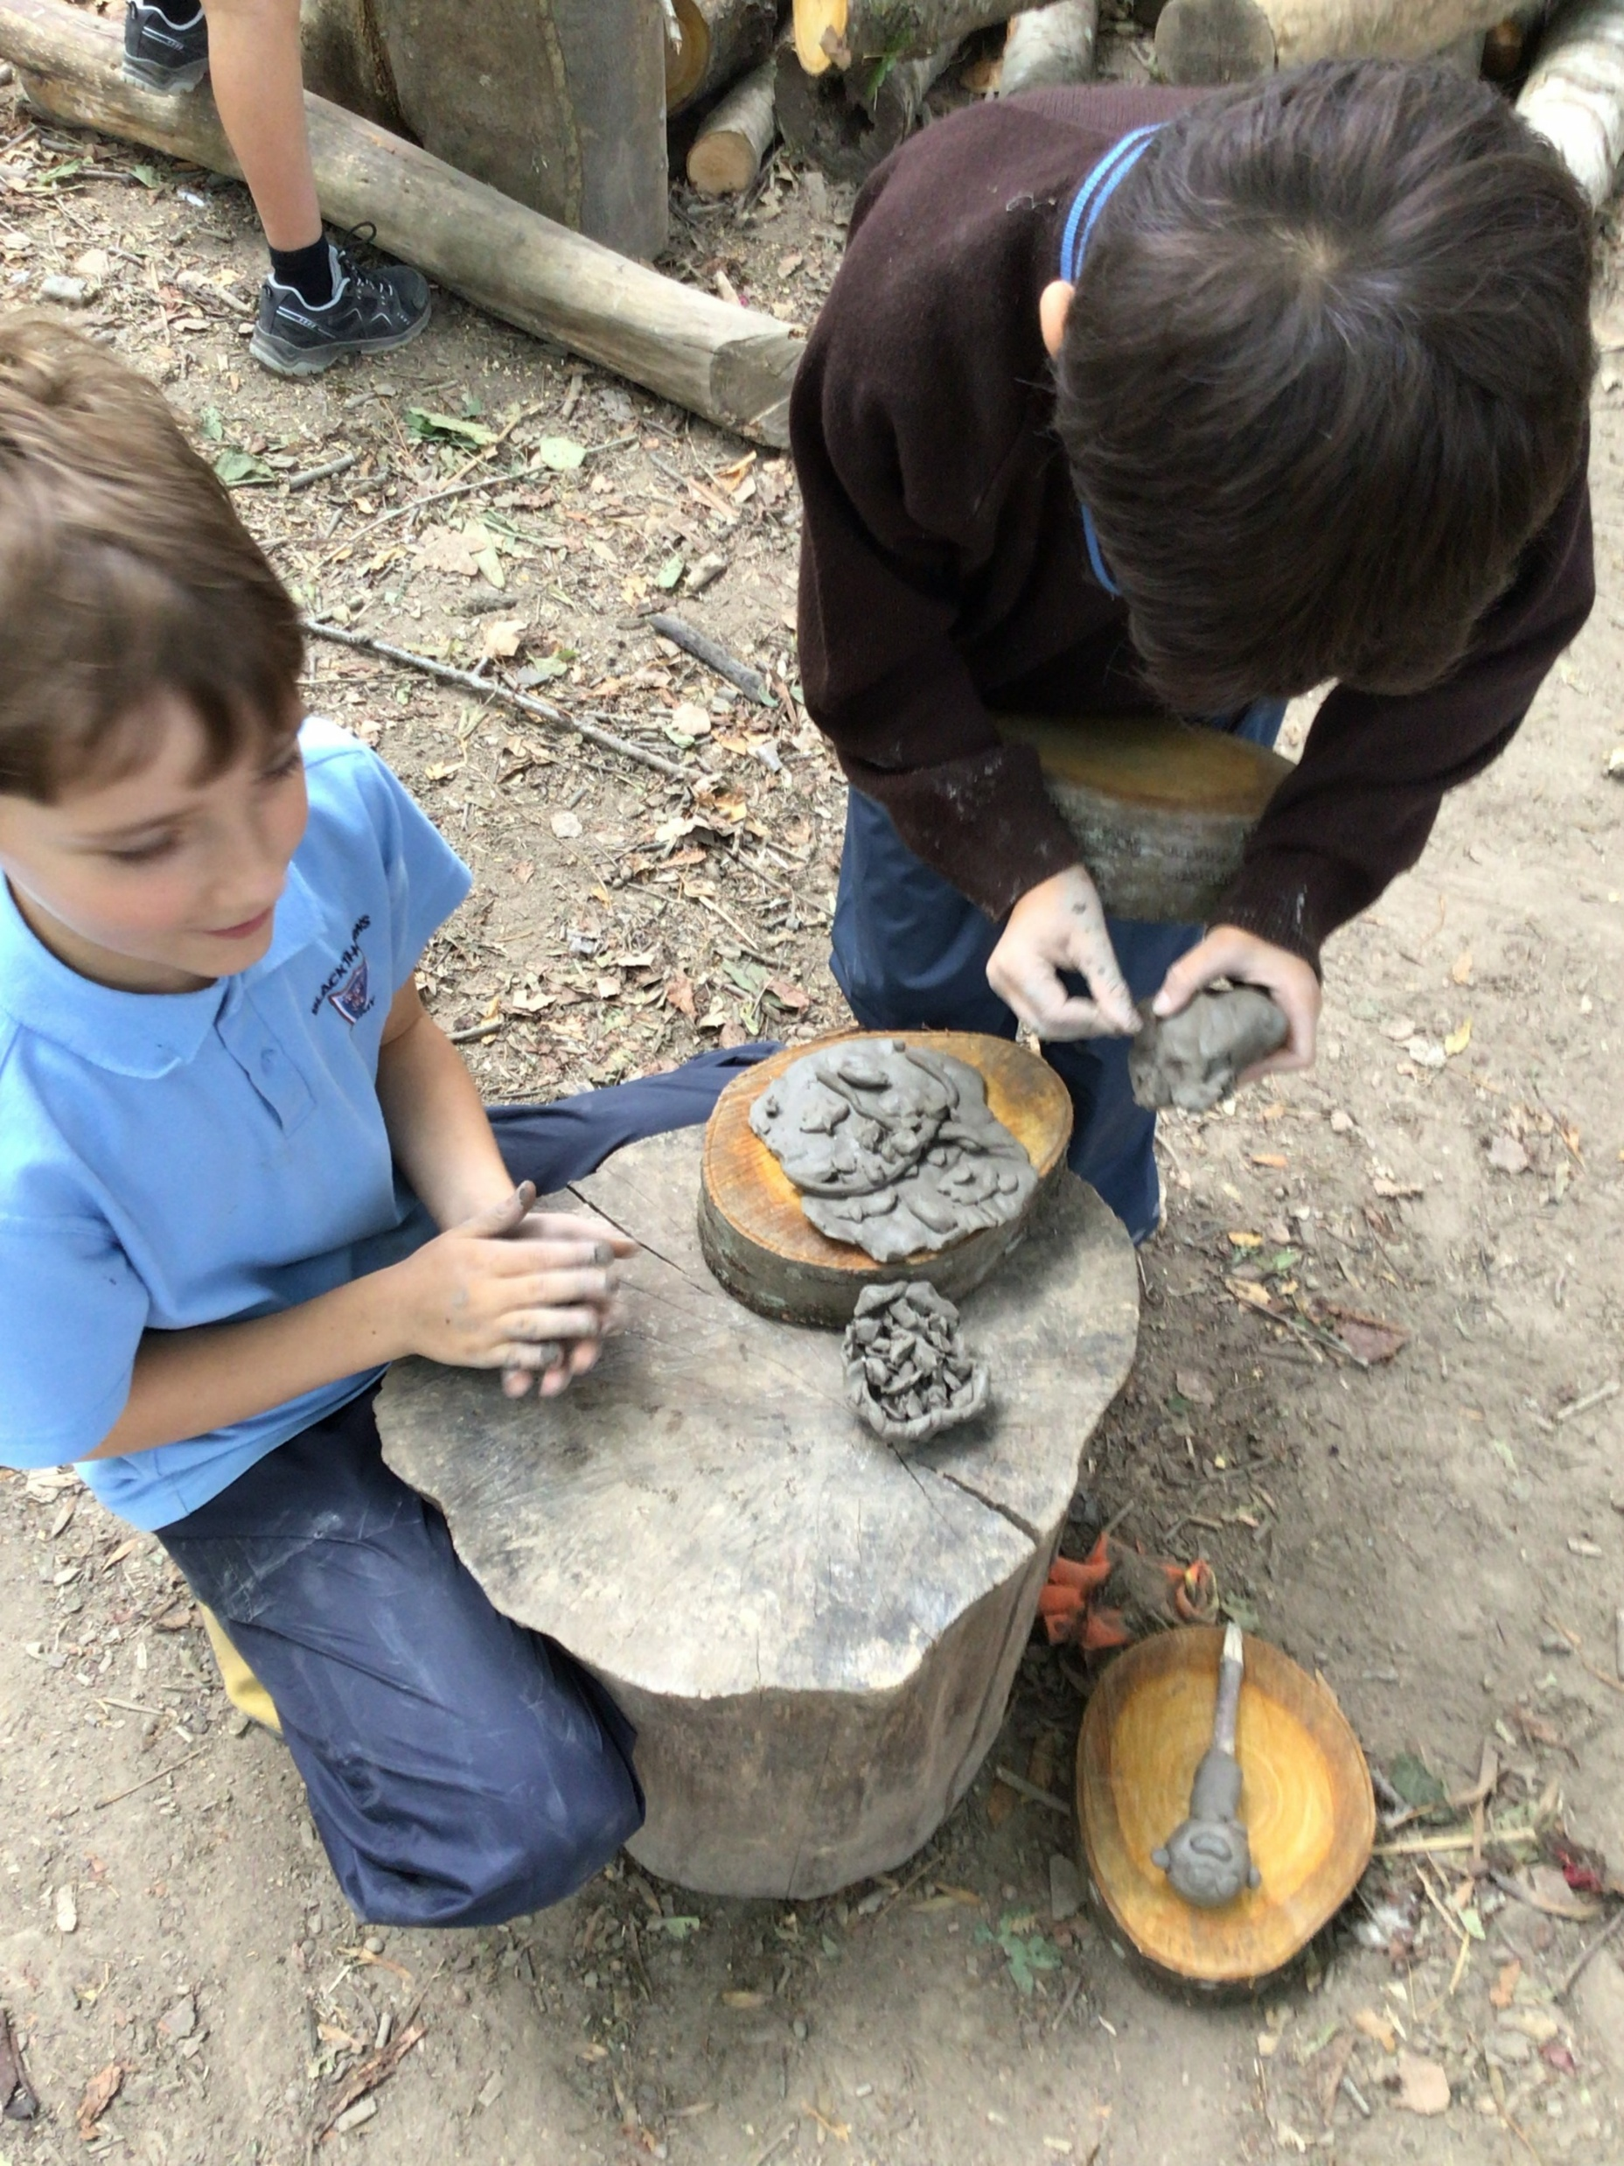
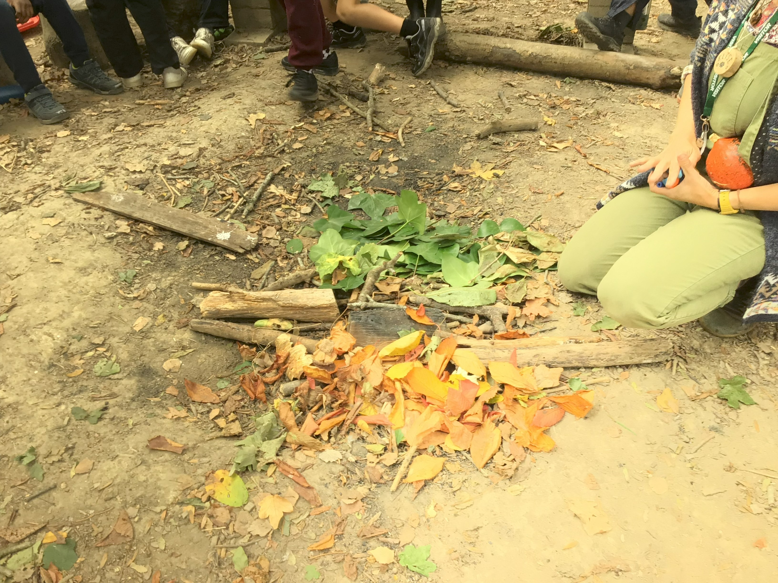
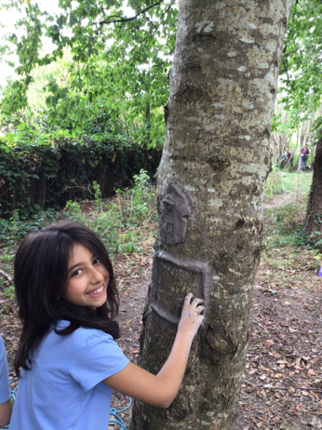
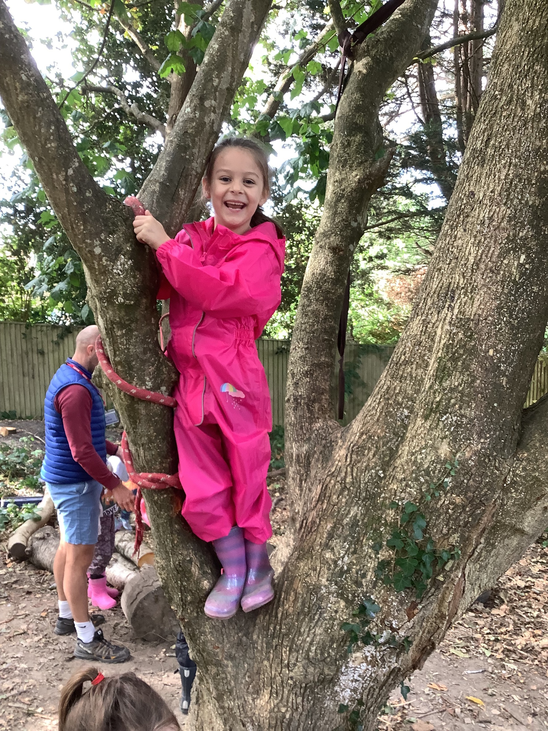
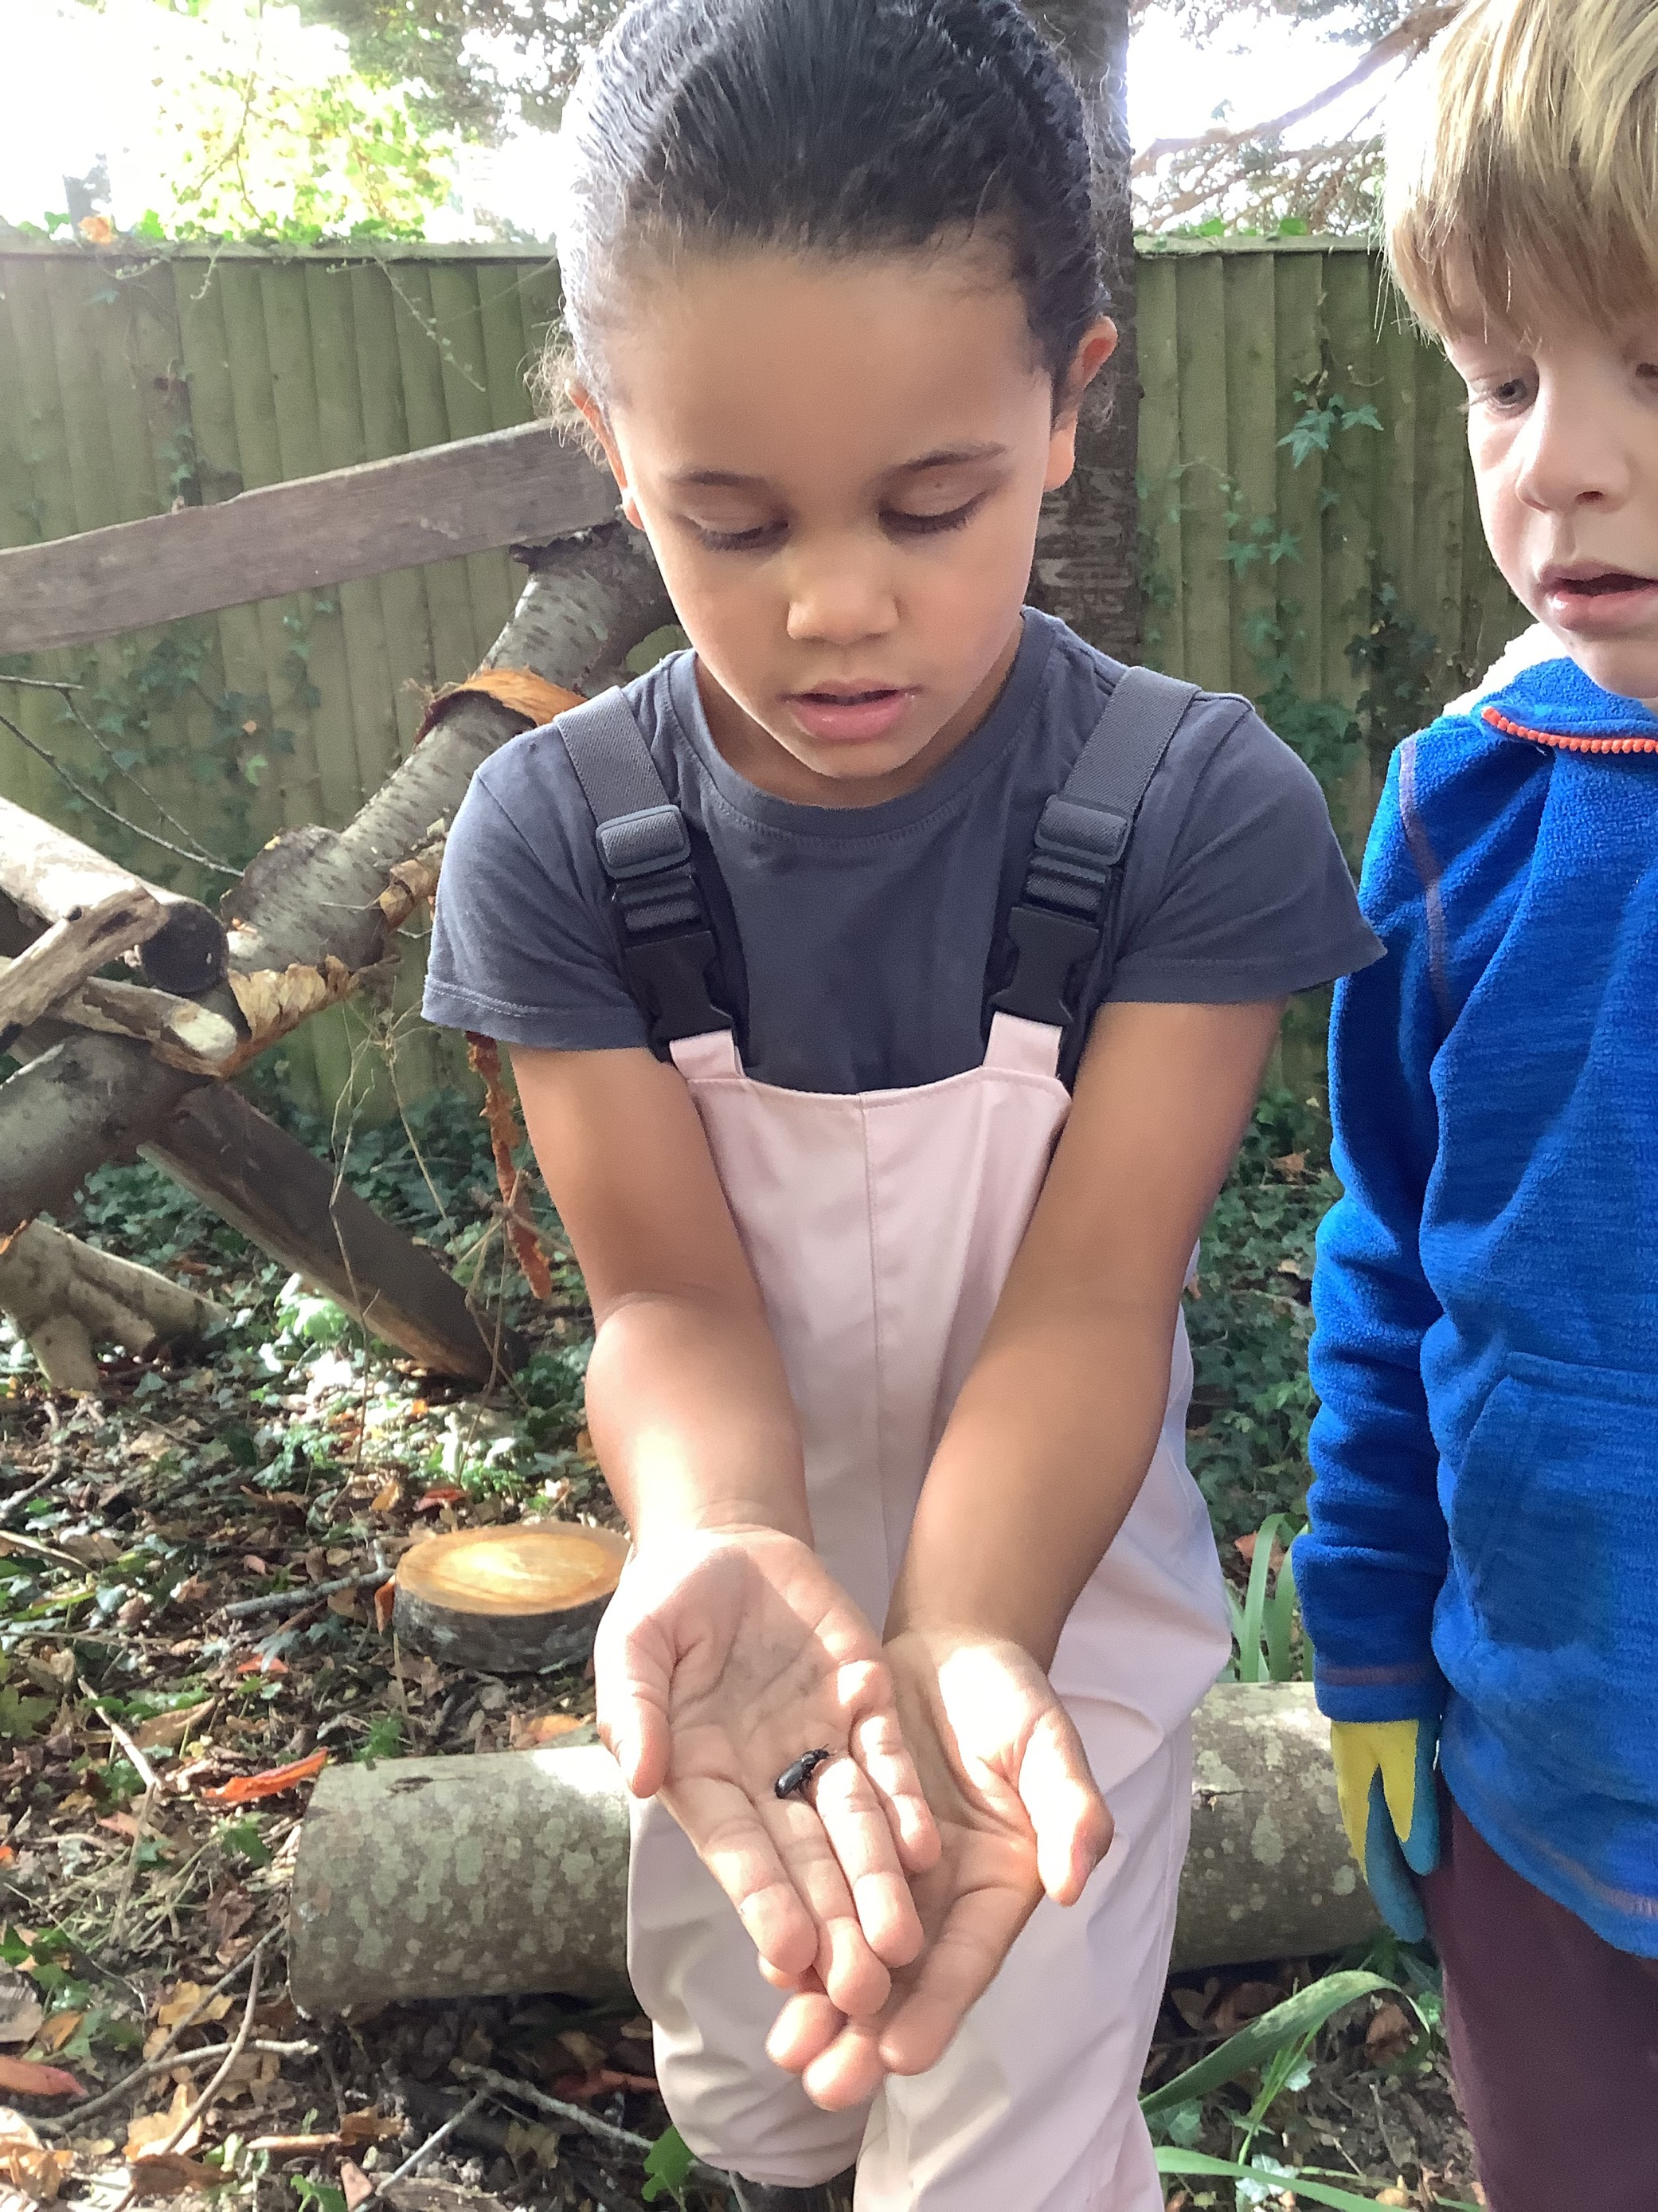
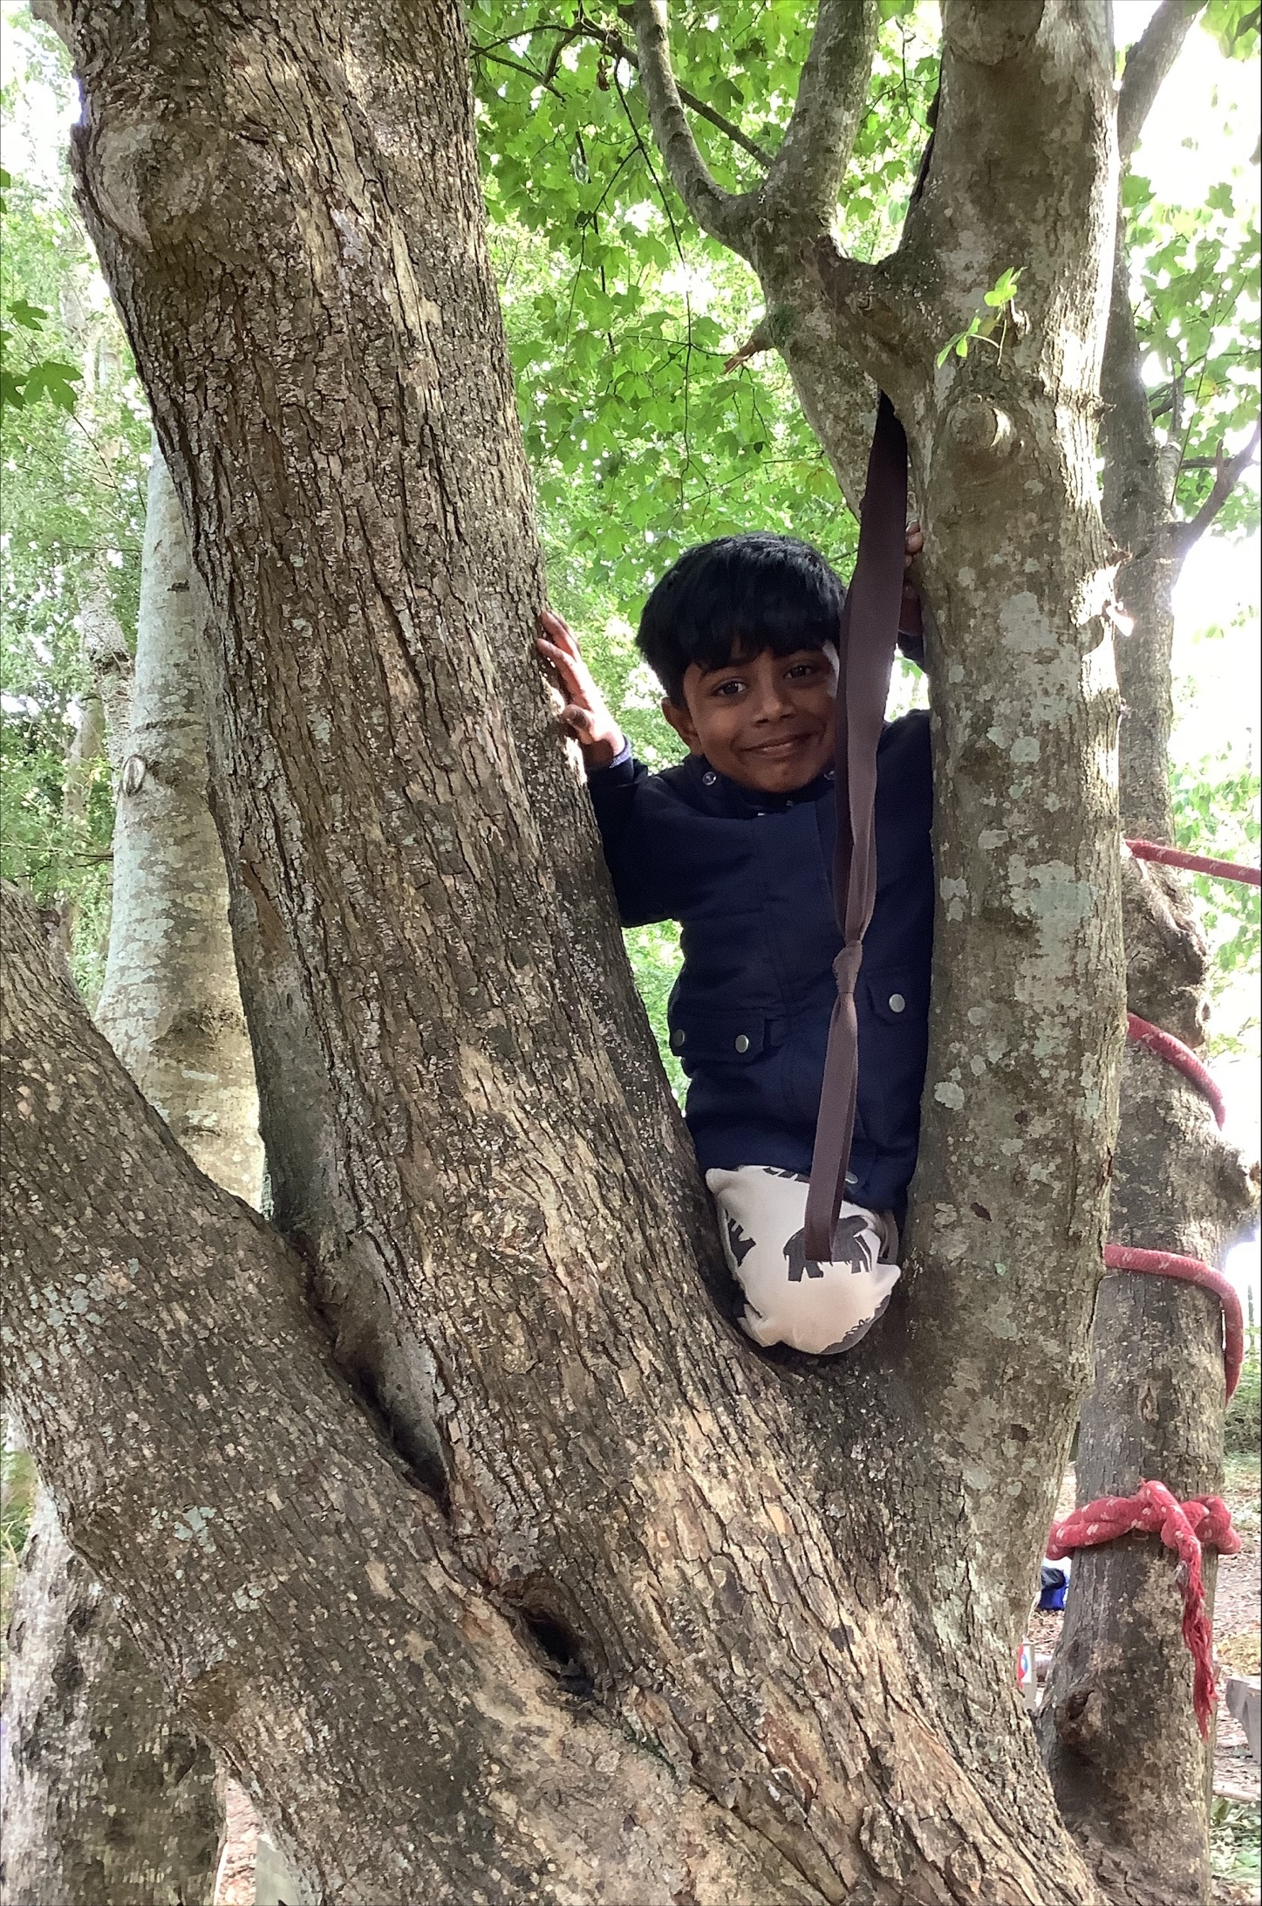
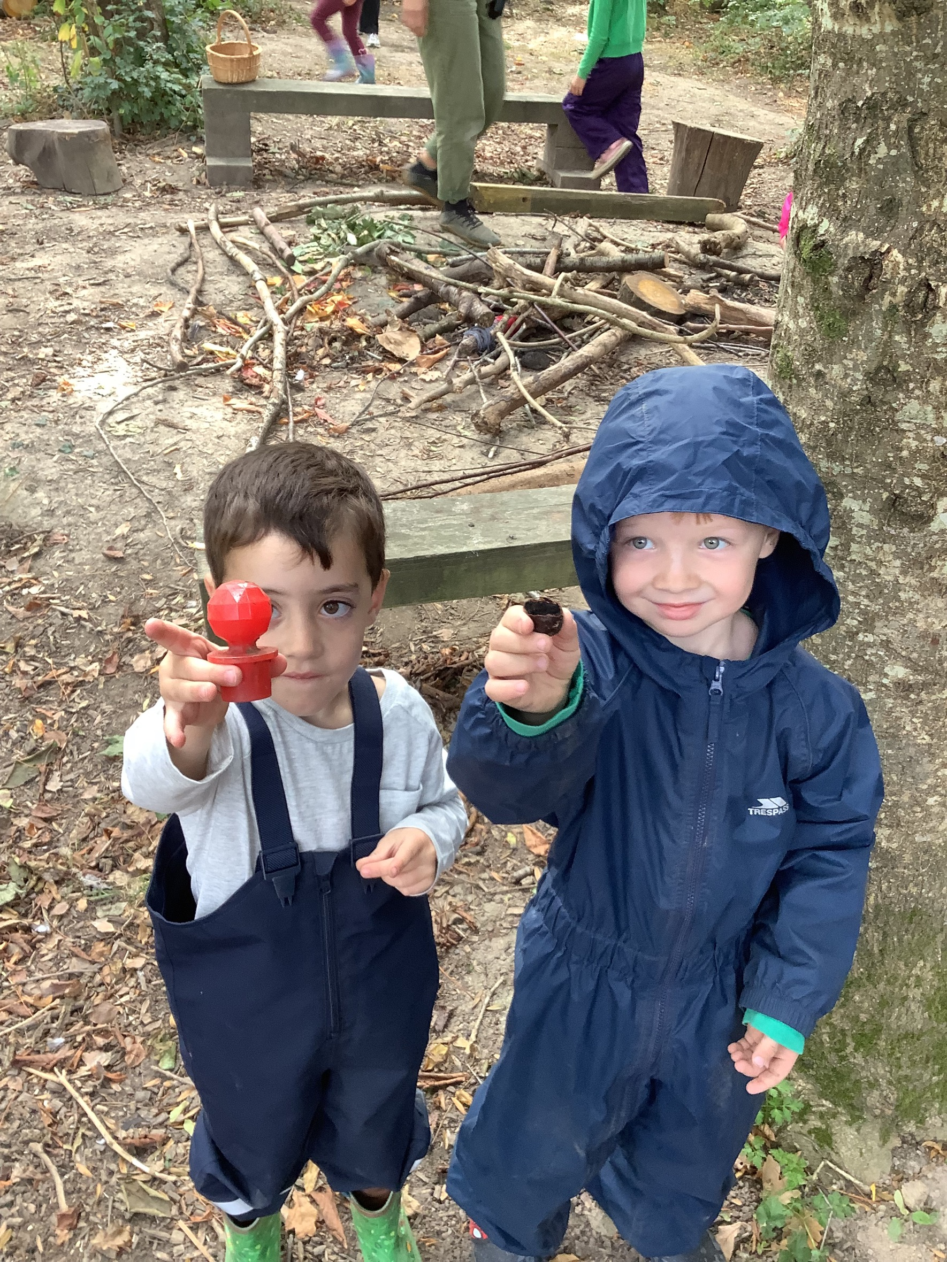
Love Your School Day 🌳
Join us on Saturday 25th September, from 10am–2.30pm, for our Love Your School Day! Come along and help us improve and brighten up our outdoor environment. Whether you can spare the whole day or just an hour, we would love to see you there. Bring your family, bring your energy and help us make Blackthorns even better!

Slide 3
Good Luck, Year 6! 🏕️
We would like to wish our Year 6 children lots of luck for their residential trip to the Isle of Wight next week! We hope they have a fantastic time, make some wonderful memories and enjoy all the adventures along the way. A huge thank you to Mrs Jago, Mrs Thomas, Mr King and Mrs Allen for giving up their time to accompany the children and make this special experience possible. We really appreciate it!
What’s Going Well Across School
It has been lovely to see a calm, positive atmosphere across the school over the past fortnight. Here are some of the highlights from each year group:
Reception - Our Reception children have completed their first full fortnight and have settled in really well. They particularly enjoyed acting out We’re Going on a Bear Hunt and have made a fantastic start to school life.
Year 1 - have been developing their writing using Colourful Semantics, which is helping children to structure their sentences and communicate their ideas clearly. They have also been focusing on building positive relationships within the class.
Year 2 - There has been a lovely focus on building relationships and developing children’s awareness of others. It has been particularly encouraging to see children noticing and empathising with the adults around them.
Year 3 - We are seeing progress across the class. It is fantastic to see their confidence growing and their hard work paying off.
Year 4 - are showing a really positive attitude to learning and are loving their current topic. They have loved talking to Henry VIII through AI!
Year 5 - It has been lovely to see them demonstrating maturity and taking increasing responsibility for their learning and behaviour.
Year 6 - There has been some fantastic writing across the year group, particularly in poetry and their current writing unit of conflict. We have been impressed by the creativity and enthusiasm the children are showing in their English lessons.
Starting School in 2027? 🎒
Do you have a child who will be starting school in September 2027? We would love to welcome you to Blackthorns and show you around our wonderful school. Come and meet Mrs Saunders, Headteacher, see our classrooms and learning environment, and find out what makes Blackthorns such a special place to learn.
Click here to book a school tour.

Slide 4
Attendance Matters
Every day at school counts! Regular attendance gives children the best opportunity to learn, make progress, build friendships and take part fully in school life. Even a few days missed can make a difference over time, so we ask all families to make good attendance a priority and support their children to be in school, ready to learn, every day they can. Thank you for your support in helping our children make the most of every school day!
Welcome to Mrs Morley!
We are delighted to welcome Mrs Morley to the Blackthorns team as a Teaching Assistant in Year 4. She has already settled in brilliantly, and we are very pleased to have her as part of our team.
Our School Development Priorities for 2026–27 🌟
I am delighted to share our key priorities for this year. These are the areas that will help us continue to make Blackthorns an even better place for every child.
1. Excellent Teaching and Learning 📚
We will continue to develop consistently high-quality teaching and assessment so that every child, including those with SEND and those working at greater depth, can achieve their very best.
2. Attendance and Behaviour 🌟
We will establish consistently high expectations for behaviour and attendance, creating a calm, safe and purposeful environment where every child can learn and thrive. We will share with you our updated behaviour policy as soon as it is finalised.
3. Early Years 🌱
We will strengthen our Early Years provision to ensure that our youngest children have an exceptional start to school and make strong progress from the moment they join us.
4. Leadership, Values and Community 🤝
As we establish our new leadership team and Governing Board, we will work together with children, staff, parents and our wider community to create a shared vision and values that shape the future of Blackthorns.
5. Improving Our Outdoor Environment 🌳
We will continue to develop our school grounds, creating engaging outdoor spaces that support children's learning, play, physical activity and wellbeing.
I am very excited about the year ahead and look forward to working with our whole school community to make these priorities a reality.

Slide 5
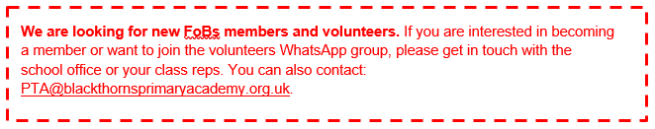
FoBs Update
As the Autumn term is in full swing, we wanted to tell everyone about FoBs: who we are, what we do, and how you can get involved.
WHAT IS FOBS?
Friends of Blackthorns (FoBs) is the Parent Teacher Association (PTA) for Blackthorns. It’s a charity and is run by parent volunteers.
WHAT DOES FOBS DO?
FOBs runs events throughout the year to raise money for the school – these funds are essential for Blackthorns. We can’t do without all of you, so please do come and support our events as these enrich the children’s school experiences.
In recent years, the money FoBs raised has funded:
The Blackthorn Forest School. We are delighted to be able to fund this again for the 2026/27 academic year.
iPads for the Y6 classroom
Resources for the reading and phonics scheme
Redecorating of KS1 And KS2 areas
Ovens for DT, Chick incubators, science supplies and more.
Art and author workshops
Playground and outdoor equipment
WHO ARE WE?
We are all parents at Blackthorns, who meet a couple of times a term. There are also staff representatives who liaise between FoBs and the school, plus a team of ad hoc parent volunteers who help out at events. Anyone is welcome!
UPCOMING EVENTS
Friday 9th October – Comedy Night. Just under two weeks to go until the Blackthorns Comedy Night! This is honestly not one to miss and the feedback from last year was great. There are only a few available tickets left to purchase online (https://www.pta-events.co.uk/blackthornsfobs/index.cfm). The bar will also be available all evening, so it’s a great chance for a social too!
Monday 30th November and Wednesday 2nd December – Festive Wreath Making Workshops
Friday 11th December – Christmas Fair and non-uniform day (in return for hamper gifts)
Friday 18th December – FoBs Christmas Lunch and Parent Raffle
We’ll share more details on these and future events soon. We also want to say a big thank you to the volunteers for the pre-loved uniform and cookie sale last week. With everyone’s support, we raised £249.

Slide 6
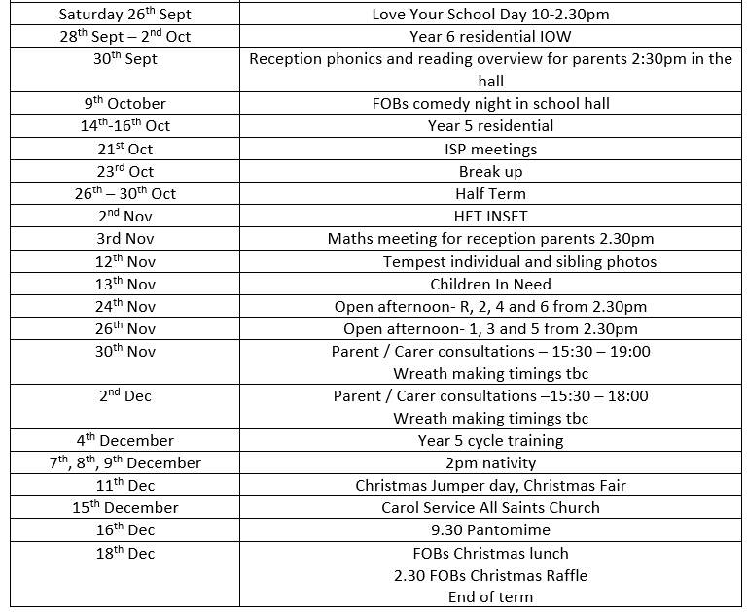
Dates for your diary. More information will follow regarding these events.
I am available at the beginning and end of the school day as much as possible, please feel free to come and speak to me should you have any queries.
EMMA SAUNDERS
Headteacher

