Slide 1


11th September 2026
BLACKTHORNS NEWSLETTER
Welcome to the first newsletter of the year!
It has been a wonderful start to the new school year, and we have been so pleased to welcome all of our children back to Blackthorns. The children have returned calmly, positively and with a fantastic attitude to their learning, and we are incredibly proud of the way they have settled back into school life. A particularly warm welcome goes to our new Reception children, who have settled in so beautifully. They have already impressed us with how well they are listening, following instructions and getting to know their new routines. It has been lovely to see so many happy faces around school, and we are looking forward to a fantastic year ahead!
Staffing News
We are delighted to welcome Miss Johnson to Blackthorns as our new Year 2 teacher. She has already made a fantastic start and is getting to know the children, families and wider school community. We are very pleased to have her as part of our team and look forward to all that she will bring to Year 2 this year. Please join us in giving her a very warm Blackthorns welcome!

Slide 2
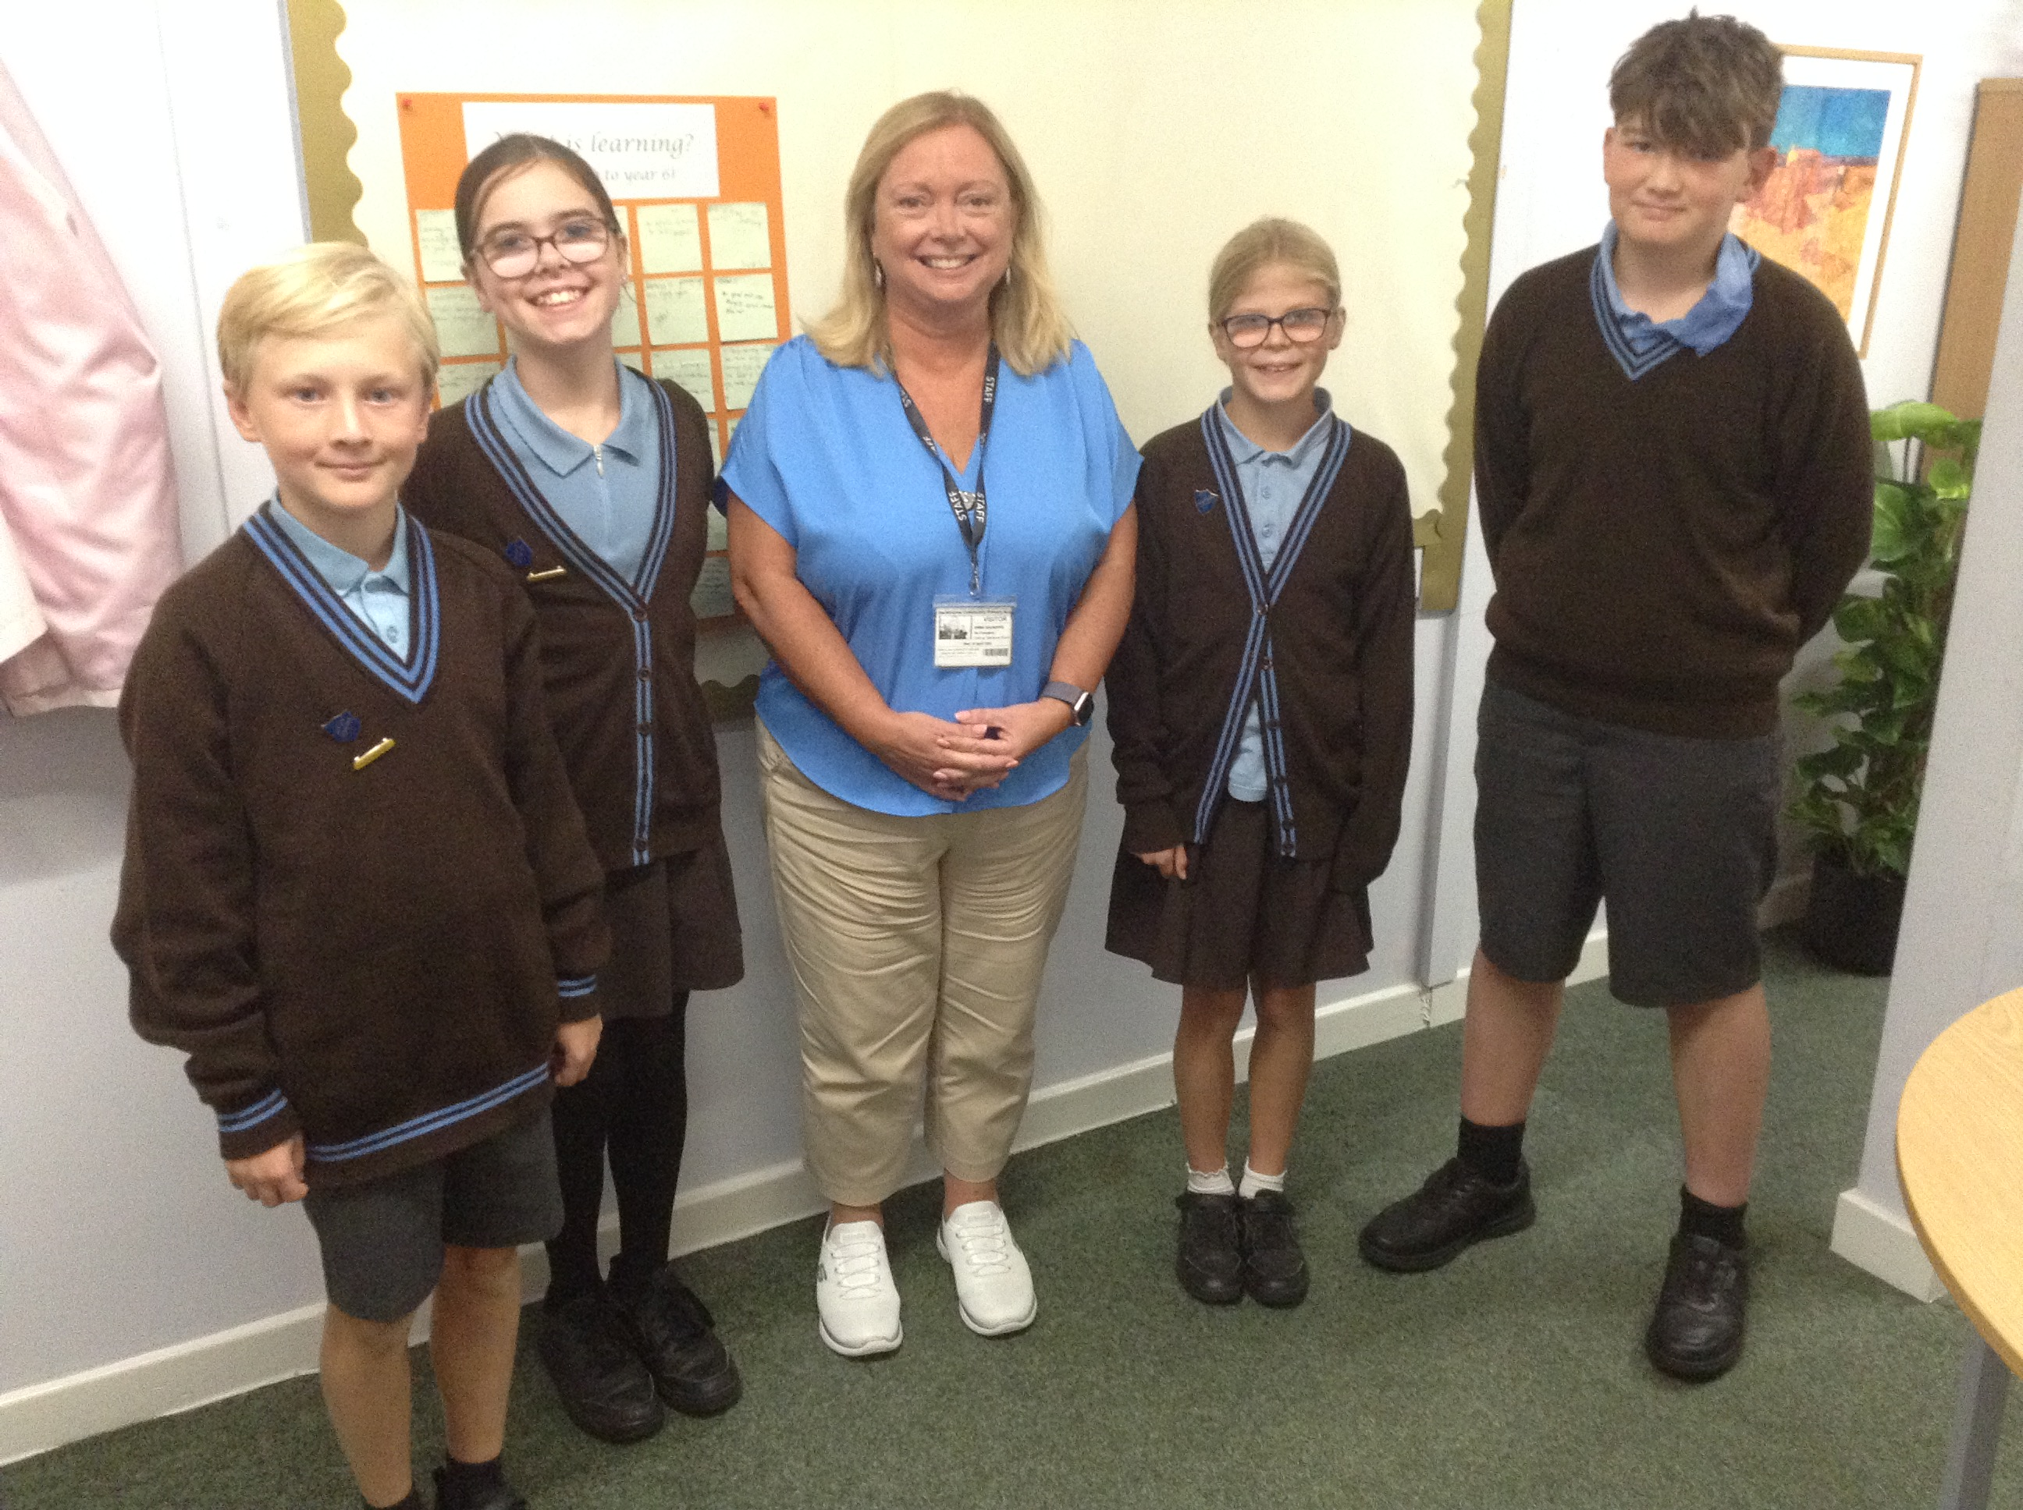
Forest School
We are very excited to be starting our Forest School sessions this year! Each class will have 10 half-day sessions across the academic year, organised into two blocks of five weeks. We know how much the children enjoy learning outdoors and exploring the natural environment, and we are looking forward to seeing them develop their confidence, independence and teamwork through these experiences. These sessions are generously funded by our Friends of Blackthorns (FOBs), and we are incredibly grateful for their continued support. Please look out for confirmation of dates and, when requested, we would be very grateful if parent/carer volunteers could sign up to support the sessions. Your help makes a real difference in enabling us to provide these valuable experiences for the children.
We are delighted to introduce our new Pupil Leadership Team for this academic year. We are very proud of them and look forward to seeing them flourish in their new roles!
Oscar, Ottilie, Lila and Stanley with Mrs Saunders
Trailblazers (Year 6) have launched into their topic of 'Conflict'. They begin with a Write Inspired project, where plasticine models were used to inspire poetry. In English they have been imagining how Neville Chamberlain might have felt before informing the country that we were at war with Germany in 1939. Mrs Thomas has introduced Henry Moore's wartime London Underground paintings as a reference point for creating some amazing artwork too. We are also REALLY looking forward to our residential to the Isle of Wight later in the month.

Slide 3
🌟 Celebrating our Ofsted report
We are delighted to share the positive findings from our recent Ofsted inspection. Achievement was judged to be a ‘Strong standard’, with inspectors highlighting that pupils achieve highly, Year 6 attainment is above national averages and pupils’ work is of a high quality. Inspectors also praised our calm and respectful behaviour, high attendance, strong support for pupils with SEND, caring and nurturing ethos, and rich opportunities for personal development and enrichment. They described Blackthorns as a “safe and welcoming school” where pupils grow in confidence, resilience and independence. We are incredibly proud of our pupils, staff and wider school community and look forward to building on these strengths as we continue to improve.
The full Ofsted report has been sent to all parents and carers, but you can also read it on the Ofsted website here: Read the full Ofsted report on the Ofsted website.
This week in Explorers (Year 2) we have been looking at the book 'Here We Are'. We have been talking about the importance of our planet and ways we can keep it safe! We have also been talking about settling into a new class and how sometimes it can be quite daunting. In PSHE this week we spoke about some of the worries we might have and created our own worry monsters to help us face them head on!
Inventors are now in full swing of Year 1 life!
Inspired by familiar Julia Donaldson stories, we have been building sentences using Colourful Semantics and developing our language and communication skills. We have also taken part in lots of circle-time discussions around ‘Being Me in My World’, sharing our thoughts and feelings about starting Year 1.
In maths, we have enjoyed lots of play-based learning, exploring Place Value within 10 through practical and engaging activities.
We have had a brilliant start to the year so far, and we are so proud of all the children and the way they have settled into their new routines.
What a fantastic start from our new Thinkers Class
Reception children, they’ve settled in so well to their new environment and routines, and it’s been wonderful to see them making new friends. We’re very proud of each and every one of them! We are looking forward to them starting full-time next week and introducing our autumn topic 'All about Me'.

Slide 4
Year 3 Warriors have made clay caves, written about the creatures they may hide and started reading 'Stone Age Boy' by Satoshi Kitamura. We have been focussing on PSHE and writing our class learning charter too.
Year 5 Innovators have had a fabulous start to the year, setting the bar high with behaviour. We have begun reading The Viewer by Shuan Tan and the children have impressed the Year 5 team with their creativity and imagination. In History we've started our Tudors topic, looking at sources to tell us what life was like during that period.
So far, this half-term, Year 4 Groundbreakers have been investigating how sound is made and how we hear different sounds through a series of observations including: rice on a drum and a tuning fork in water! In history, the children have begun to learn about some famous British monarchs and how they changed the monarchy and Britain. Through the safe use of AI, the children found themselves talking to Henry VIII about his life through an online chatroom! Linked to this topic, Year 4 have sparked their imagination, using the sound of a royal fanfare to inspire their ideas for their narratives in English.
FOBS NEWS!
We have a uniform and cookie/ donut sale on Friday 18th September.
* Cash and card accepted.
* £2 per uniform item
* £1 for cookie/doughnut.
* Gates will be opened at 3pm for easy browsing before the kids are released!

Slide 5
Dates for your diary. More information will follow regarding these events.
14th Sept | Curriculum meeting – Y6– 3:30 – in classroom
15th Sept | Curriculum meeting – Y5– 3:30 – in classroom
16th Sept | Influenza vaccination session R-6
18th Sept 3pm | Preloved uniform sale and cookie/donut sale
25th Sept | Shine Bright Dress up day
Saturday 26th Sept | Love Your School Day 10-2.30pm
28th Sept – 2nd Oct | Year 6 residential IOW
30th Sept | Reception phonics and reading overview for parents 2:30pm in the hall
9th October | FOBs comedy night in school hall
14th-16th Oct | Year 5 residential
21st Oct | ISP meetings
23rd Oct | Break up
26th – 30th Oct | Half Term
2nd Nov | HET INSET
3rd Nov | Maths meeting for reception parents 2.30pm
12th Nov | Tempest individual and sibling photos
13th Nov | Children In Need
24th Nov | Open afternoon- R, 2, 4 and 6 from 2.30pm
26th Nov | Open afternoon- 1, 3 and 5 from 2.30pm
30th Nov | Parent / Carer consultations – 15:30 – 19:00 Wreath making timings tbc
2nd Dec | Parent / Carer consultations –15:30 – 18:00 Wreath making timings tbc
4th December | Year 5 cycle training
7th, 8th, 9th December | 2pm nativity
11th Dec | Christmas Jumper day, Christmas Fair
15th December | Carol Service All Saints Church
16th Dec | 9.30 Pantomime
18th Dec | FOBs Christmas lunch 2.30 FOBs Christmas Raffle End of term
I am available at the beginning and end of the school day as much as possible, please feel free to come and speak to me should you have any queries.
EMMA SAUNDERS
Headteacher

